Slide 1
HOUSE PRICE PREDICTION
Project 4

Slide 2

HOUSING PRICE PREDICTION OF MELBOURNE USING MACHINE LEARNING
Project Introduction
Challenges in Property Market Decision-Making
Advantages of Machine Learning
Project Goal
Data Source
https://www.kaggle.com/datasets/anthonypino/melbourne-housing-market
Data from 2016 - 2018

Slide 3
PROJECT OBJECTIVE
For Families: to help determine what is accessible with their budget.
For Investor: looking for profitable investment opportunities

Slide 4








TECHNOLOGIES USED
Python/Pandas/Numpy
Jupyter Notebook
SciPy
Scikit-learn
Flask
HTML/CSS
JavaScript
Google Maps

Slide 5
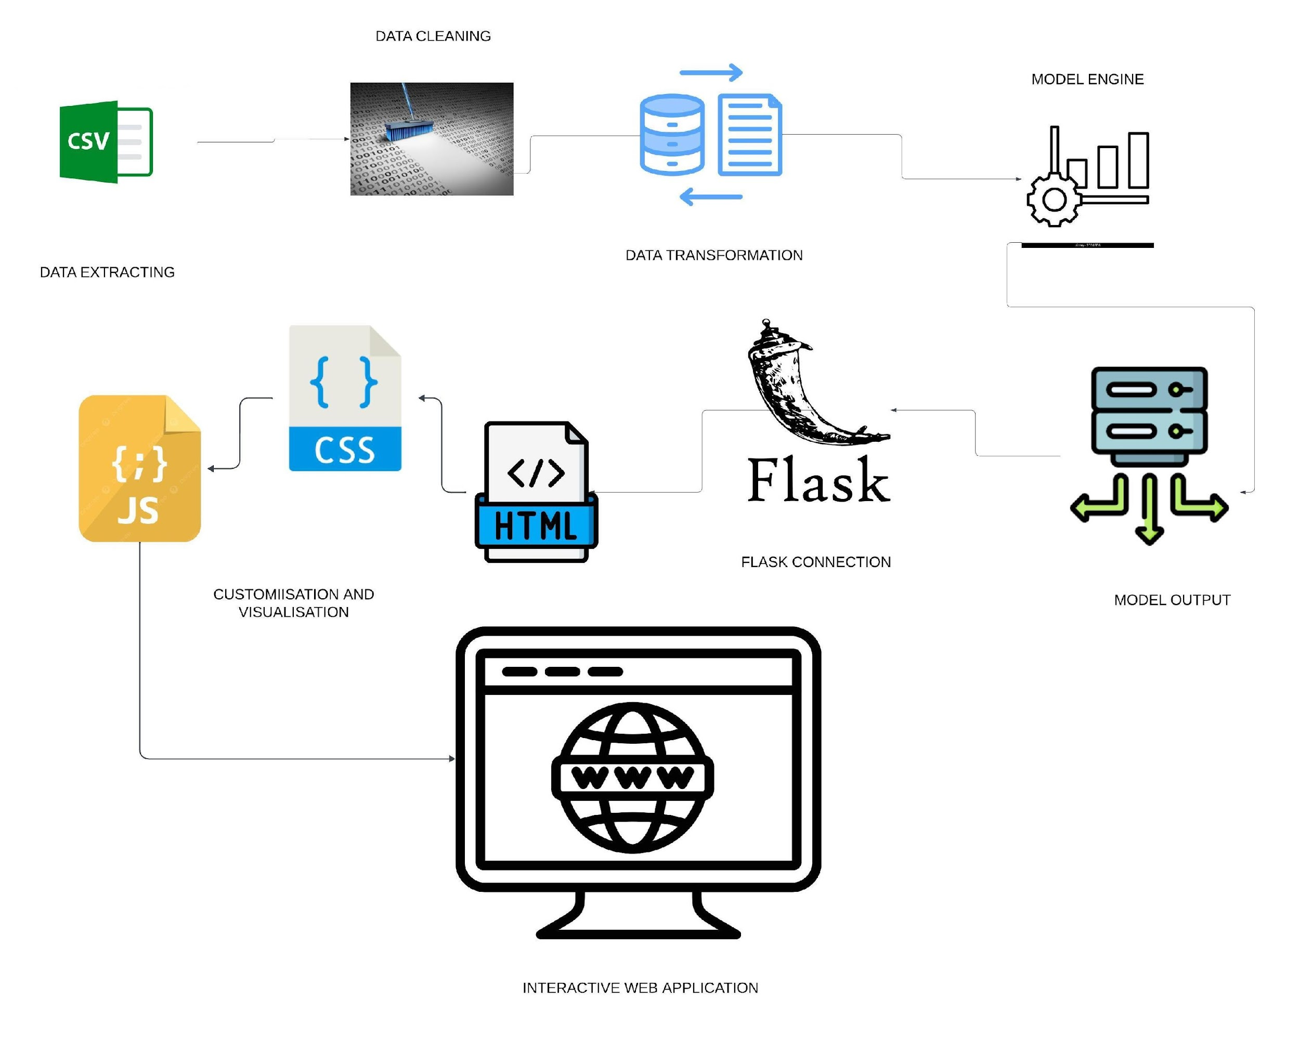
ETL PROCESS

Slide 6

EXPLORATORY DATA ANALYSIS(EDA)

Slide 7
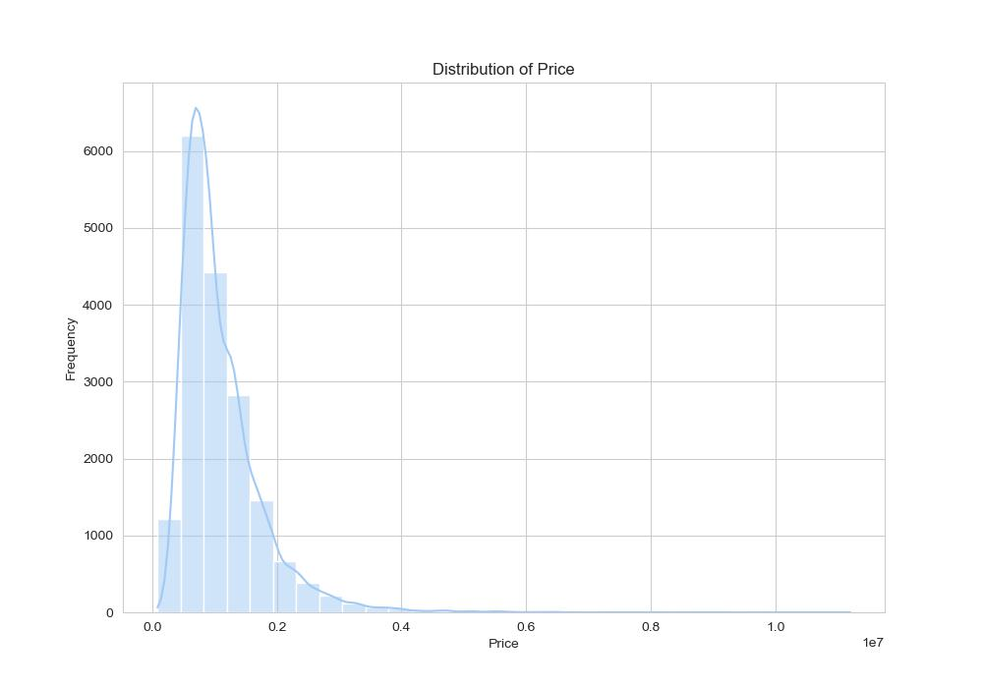
DATA DISTRIBUTION

Slide 8
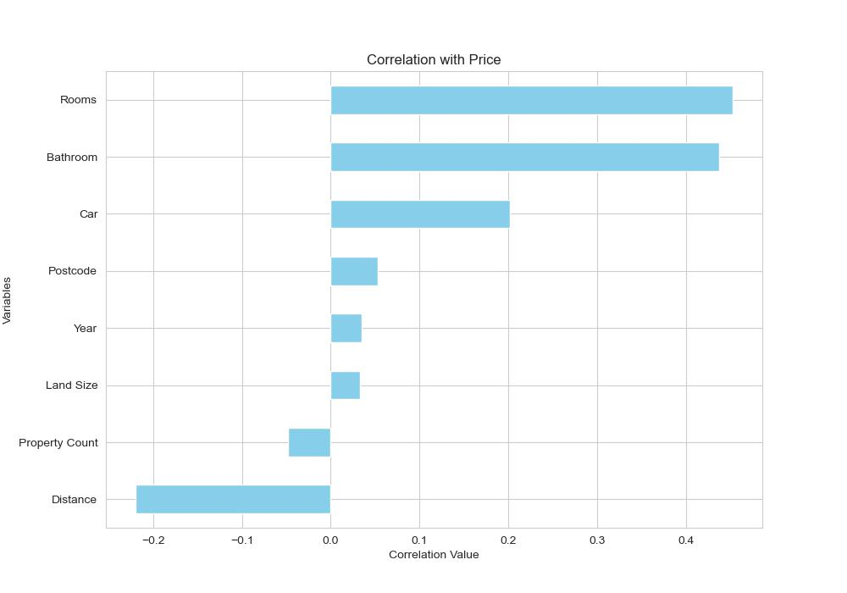
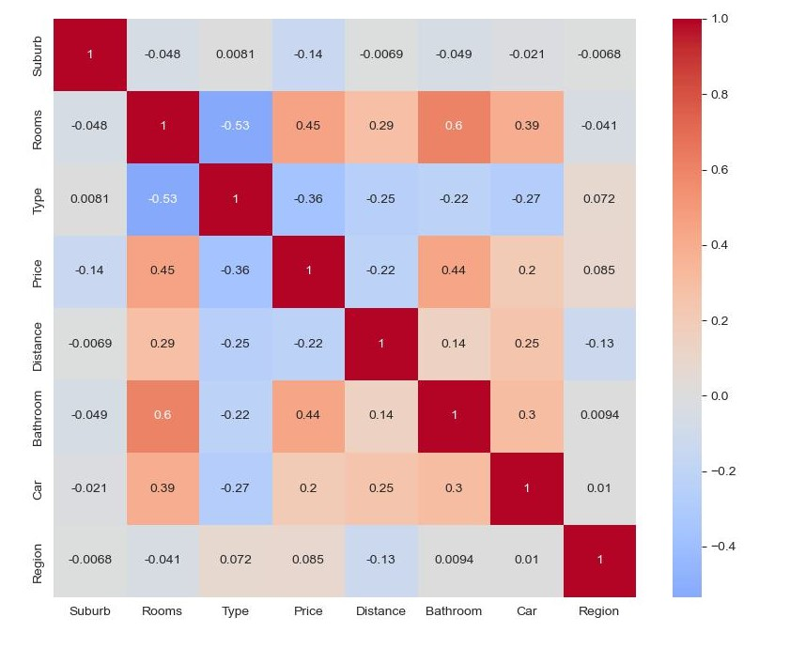
CORRELATION ANALYSIS

Slide 9
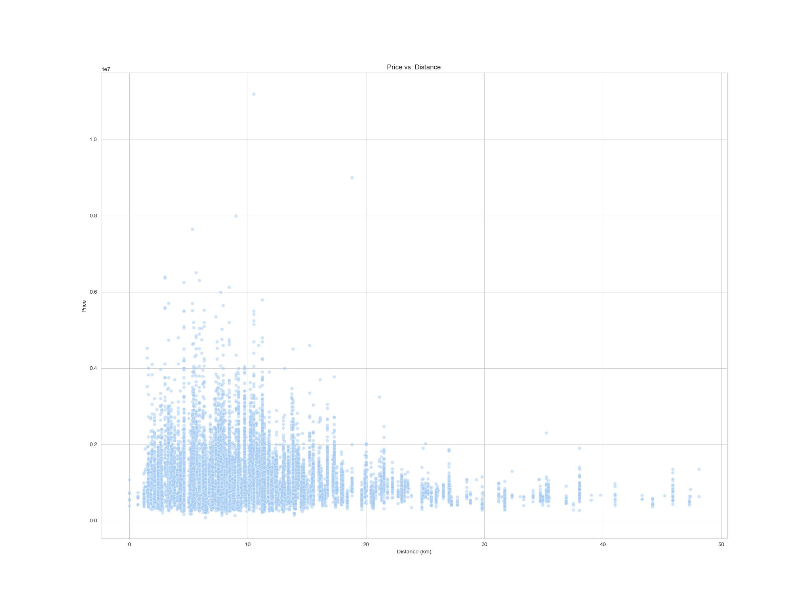
PRICE VS. DISTANCE

Slide 10
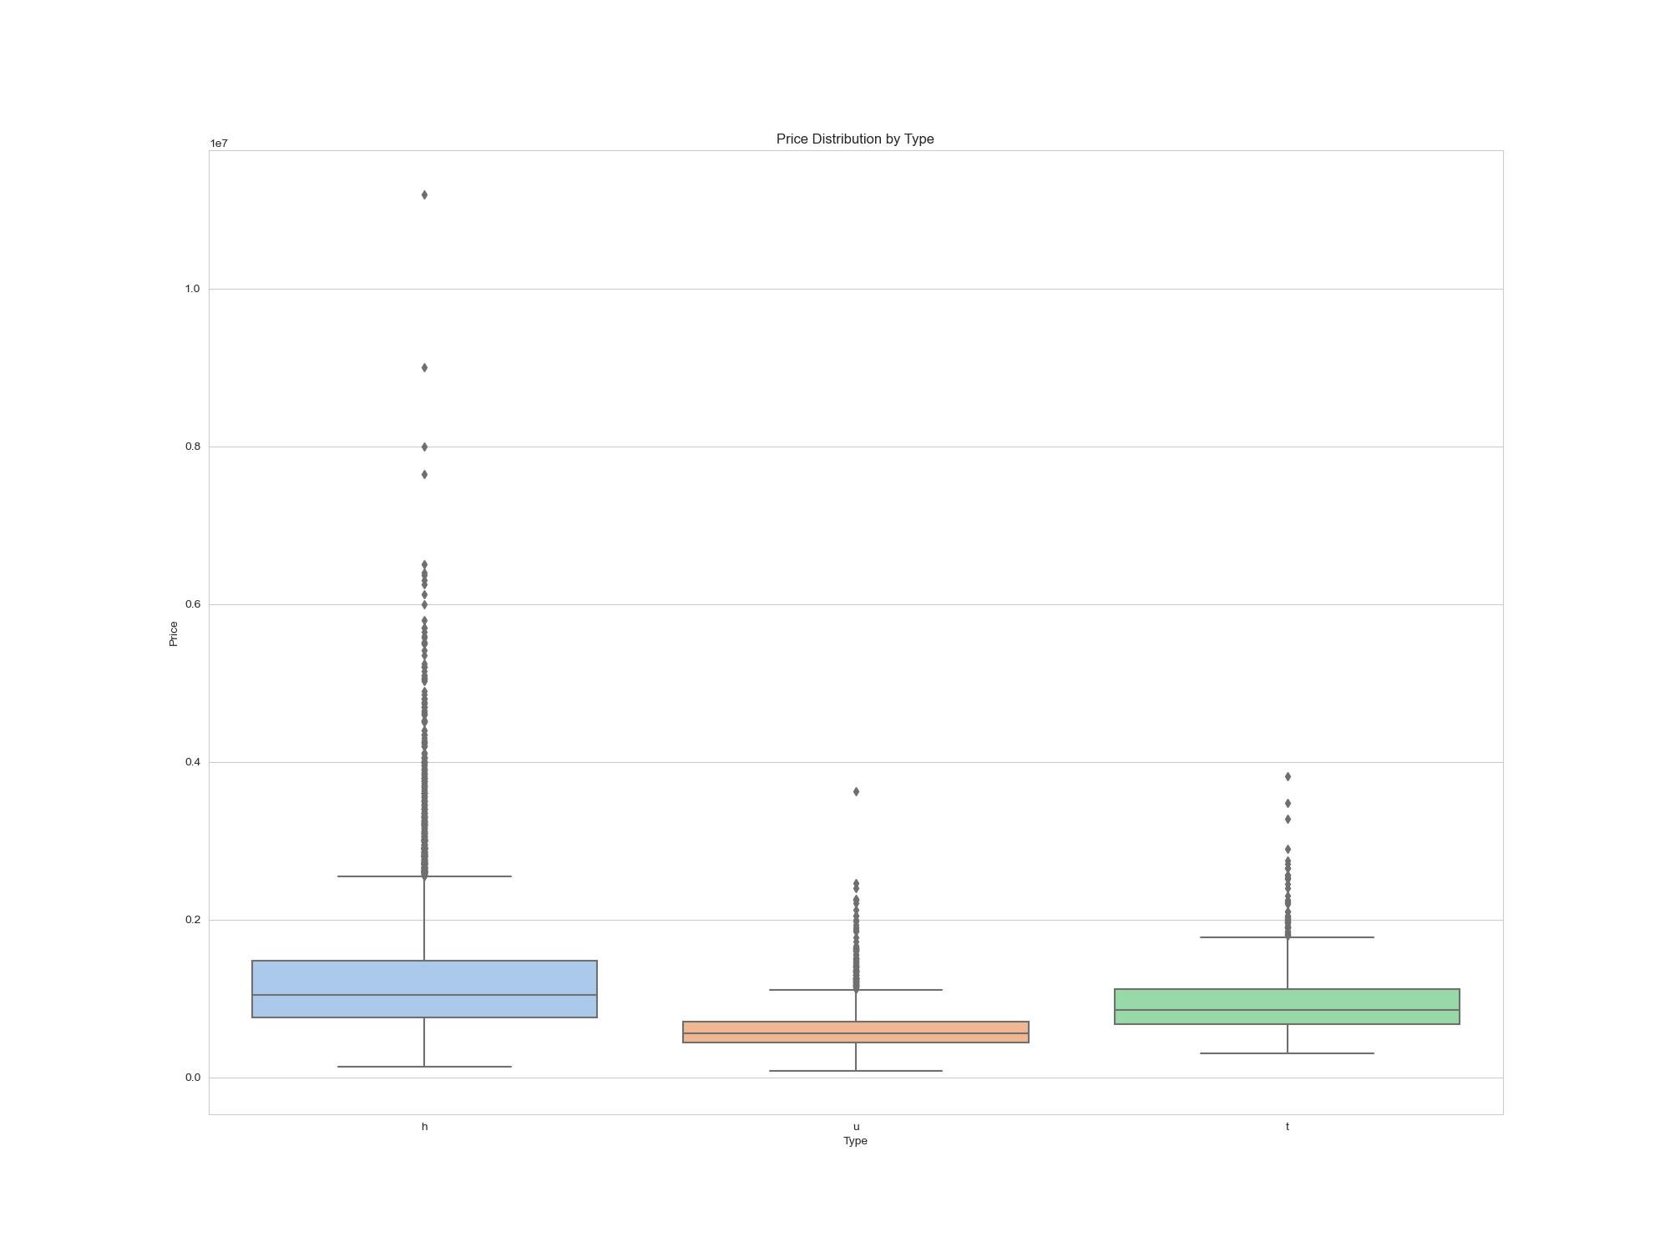
PRICE VS. PROPERTY TYPE

Slide 11
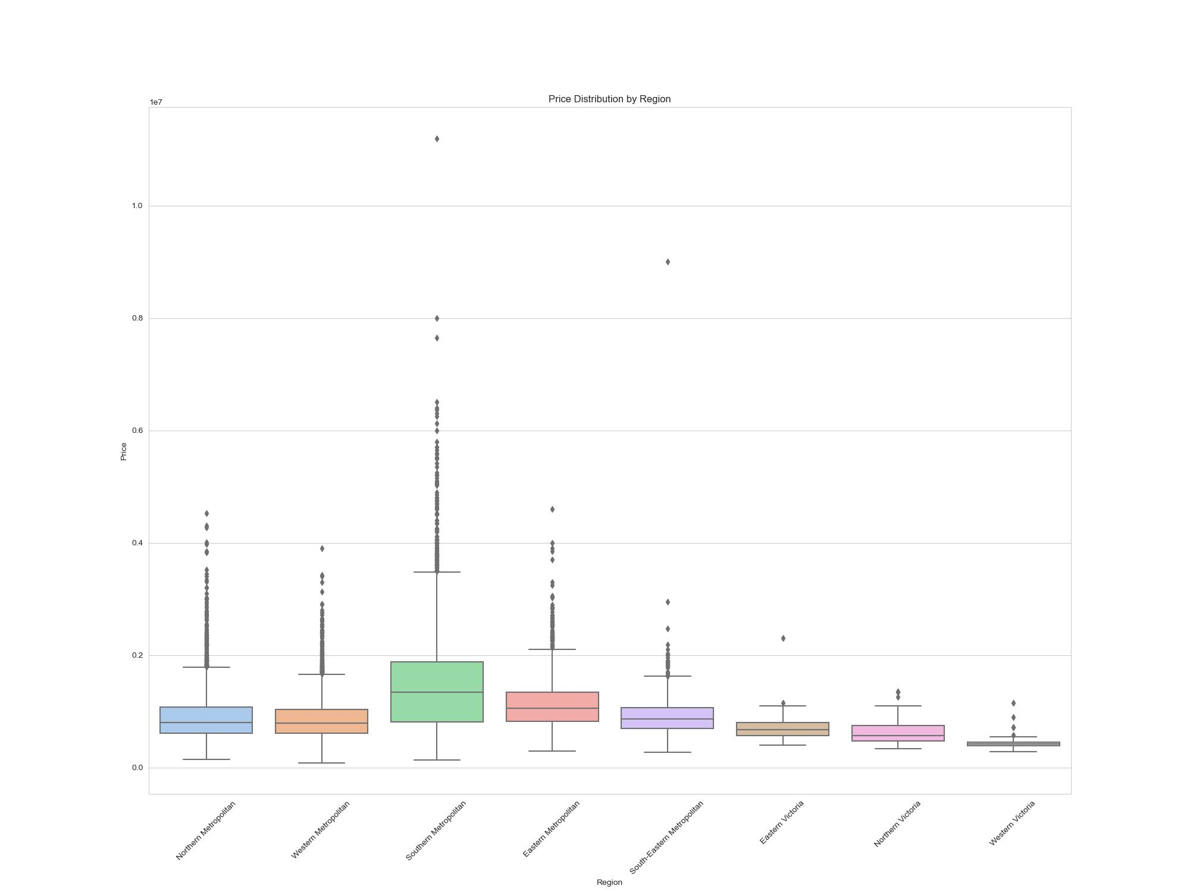
PRICE VS. REGION

Slide 12
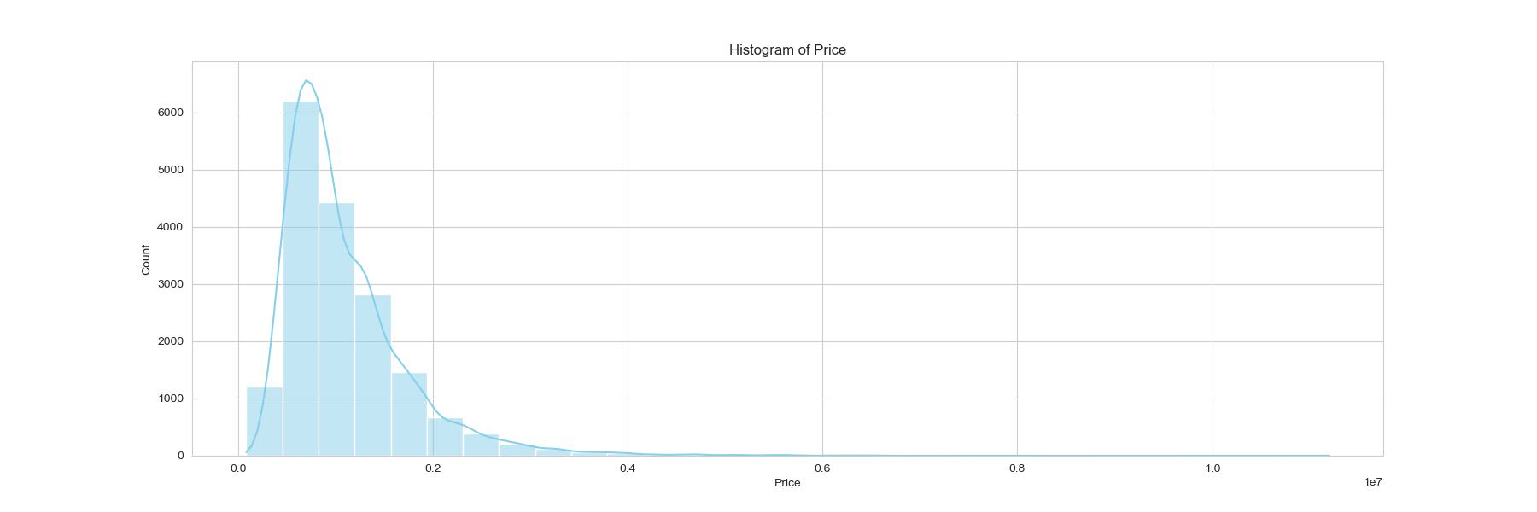
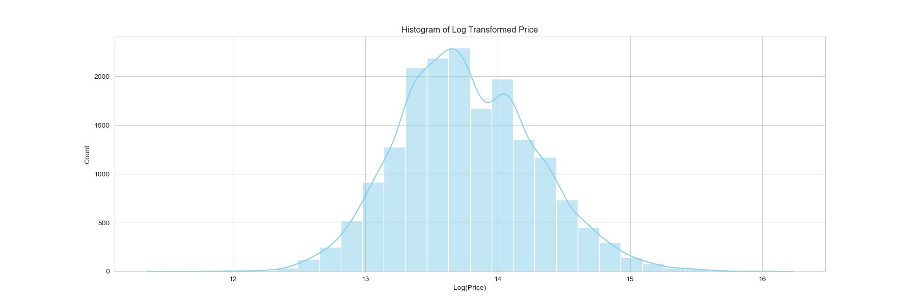
NORMALIZATION OF TARGET FEATURE(PRICE)

Slide 13
MODEL ANALYSIS
Linear Regression Model
Decision Tree Regression Model
Gradient Boosting Regression Model
Random Forest Regression Model
Support Vector Regressor Model
Lasso Model
Ridge Model
Randomized Search CV

Slide 14
MODELS TESTED
 | Train Score | Test Score
Linear Regression | 0.539060 | 0.518700
Gradient Boosting Model | 0.796061 | 0.774109
Random Forest | 0.911494 | 0.789304
Tuned Random Forest | 0.883882 | 0.801776
Decision Tree Model | 0.922393 | 0.737253
Tuned Decision Tree | 0.846100 | 0.779728
Support Vector | 0.785861 | 0.753859
Lasso Model | 0.0 | -2.194192
Ridge Model | 0.539060 | 0.518702

Slide 15

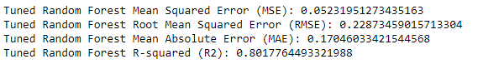

MODEL SCREENSHOT

Slide 16
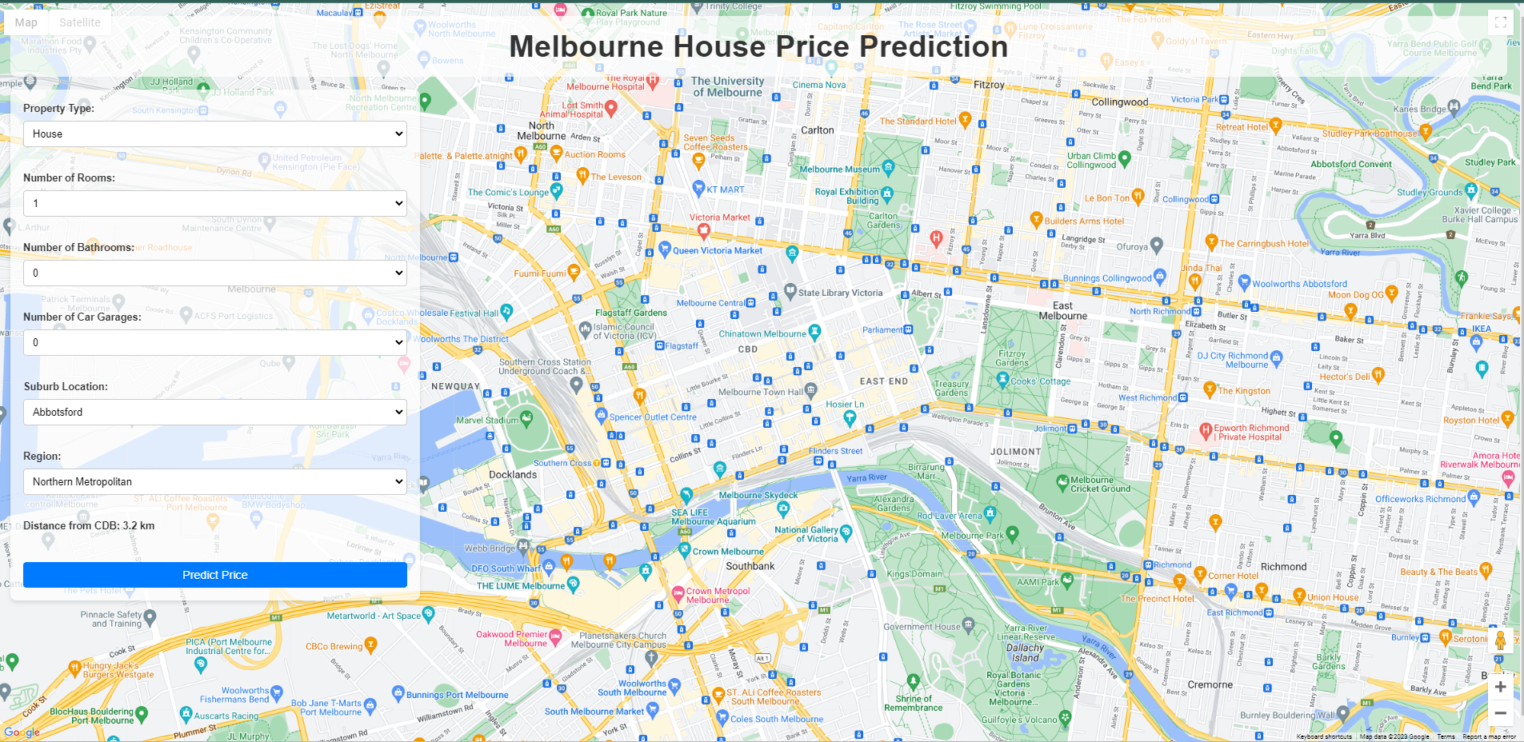
WEBSITE

Slide 17
CONCLUSION
Machine learning offers a powerful tool for making informed decisions in the property market. By utilizing historical data and predictive modeling, both families and investors can benefit from insights that weren't previously accessible. We encourage users to explore our model, provide feedback, and even contribute to its further development.

Slide 18
THANK YOU
Akbar Fadillah
Jorge Chicas
Raviska
Sameer Hooda

